Slide 1
FROM MAGADHA TO THANESWAR

Slide 2
Chandragupta Maurya came into power at Magadha in 321 B. C. E.
This was the start of Mauryan Empire.
We got informations about Mauryan Empire from two books.
Indica – Megasthenes
Kautilya's Arthashastra

Slide 3
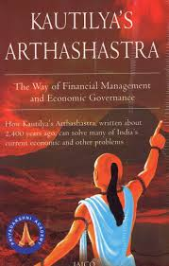


Slide 4
Kautilya, in his Arthashastra mentions about the seven elements essential for a state. They are known as the 'Saptangas' (Seven limbs).

Slide 5
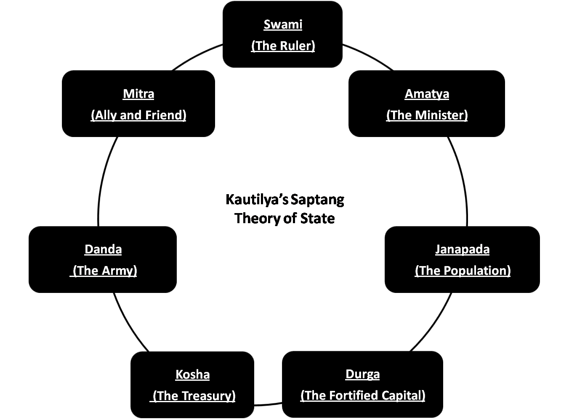

Slide 6
Seven Limbs
Svami The king
Amatya The minister/official
Kosa The treasury/Tax
Danda The Judiciary
Durga The fort/army
Mitra The ally
Janapada The territory

Slide 7
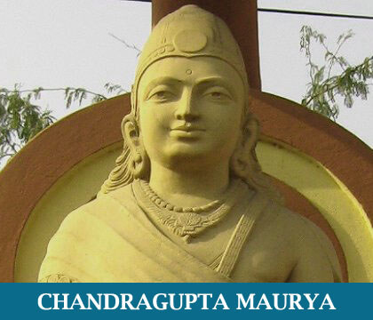
Chandragupta Maurya established a rule based on the Saptanga concept.
Pataliputra was the capital of the Maurya dynasty.

Slide 8
He formed a strong army and expanded his kingdom by conquering neighbouring states.
He collected various taxes for meeting the administrative expenses.
He made alliance with many foreign countries.
Chandragupta Maurya was the head of the administration and judiciary.
There were ministers and number of officials who helped him in the administration.

Slide 9
What are the factors that brought Maurya kingdom the status of the first empire in India?
Kingdom was extensively large.
Administration was centred on the king.
Unified administration established throughout the whole state.

Slide 10
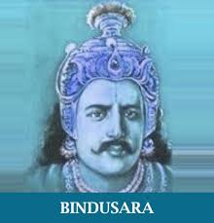
Chandragupta Maurya was succeeded by Bindusara.
Ashoka became the ruler of the Maurya empire after Bindusara.
He extended the empire conquering Kalinga and Kashmir.

Slide 11
Asoka’s India

Slide 12
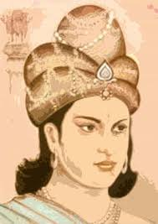
Ashoka and Dhamma
Dhamma
The word Dhamma is the prakrit form of the sanskrit word Dharma

Slide 13
What were the aims of establishing Dhamma?
Asoka’s empire was very vast.
There was a supreme need to instill unity, peace and harmony among the people in the vast country where the Brahmanas and non-brahmana sramanas (Jains, Buddhists, Ajivikas, etc.) inhabited. This motivated Ashoka to introduce the Dhamma.

Slide 14
Ashoka was inspired by Buddhism to proclaim Dhamma.
But the ideas of various religions can be seen in Dhamma.
He considered the relation between the king and his people similar to the relation between father and children.
He lessened the punishments and urged for a simple living.

Slide 15
Edicts of Ashoka
Ashoka erected edicts in various parts of the country and made inscriptions on rocks.
Most of them were near cities and highways.
The edicts can be classified as
major rock edicts,
minor rock edicts and
pillar edicts.
These edicts are also examples of artistic skills of that period.

Slide 16
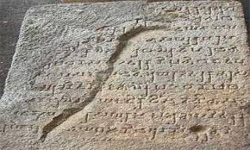
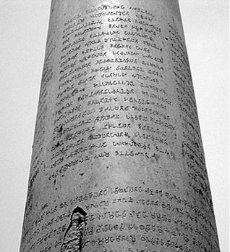
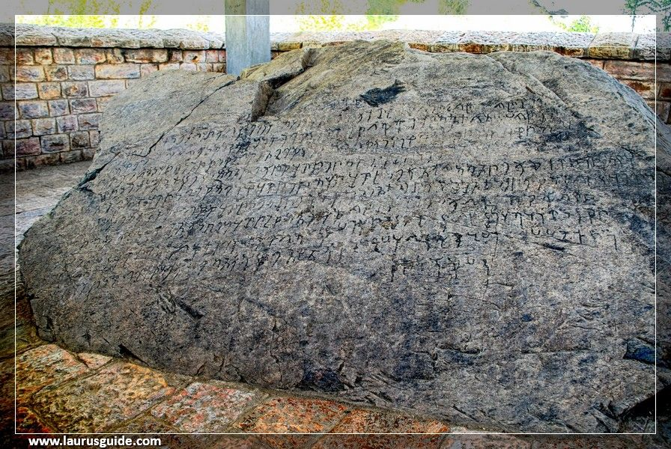

Slide 17
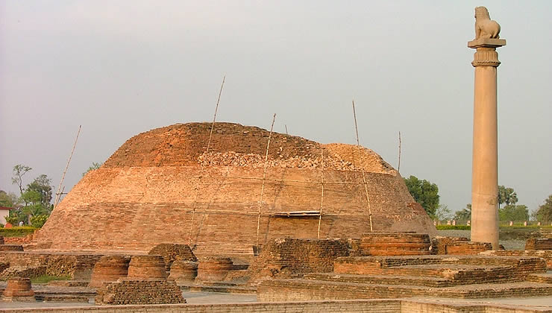
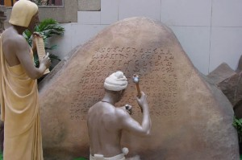
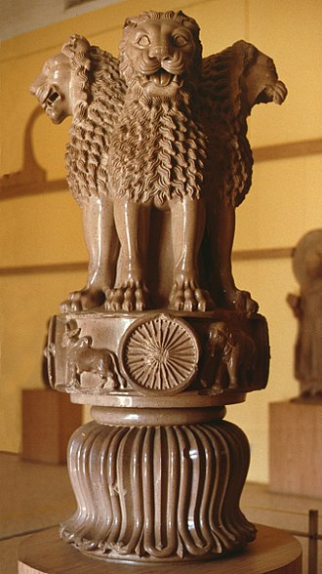
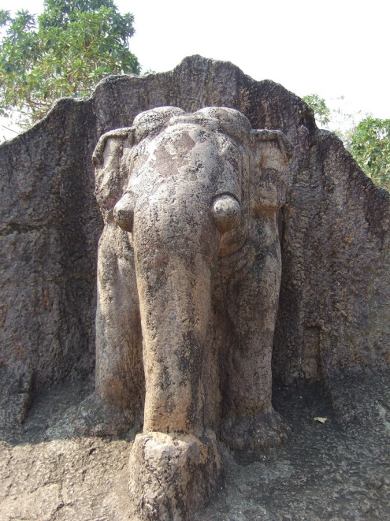

Slide 19
Ashoka sent officers to different parts of the country and other countries to propagate Dhamma.
He sent his son Mahendra and his daughter Sangamitra to Ceylon (now Sri Lanka).

Slide 20
Ashoka installed stupas containing the relics and left overs of Buddha in various parts of the country.
The most important among them is the Sanchi stupa. These were the artistic profiles of that age.

Slide 21
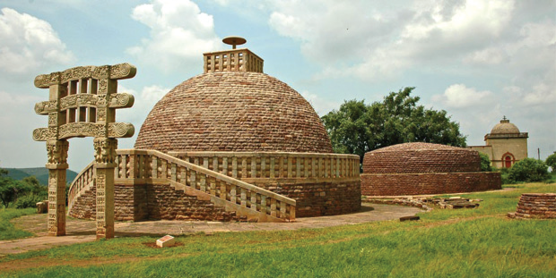
Sanchi stupa

Slide 22
Economic Life
The economic activites of the Maurya empire were controlled by the state.
The conquered regions were brought under cultivation.
Irrigation facilities were arranged for the development of agriculture.
The development of agriculture and villages led to the development in trade.
Roads were established for the development of trade.
Roads were built connecting the cities of Vaishali , Kapilavastu and Pataliputra to distant places.

Slide 23
During the reign of Ashoka's successors the power of the king and the influence of Dhamma were weakened.
As a result, many farther province became independent.
This was a cause for the decline of empire.

Slide 24
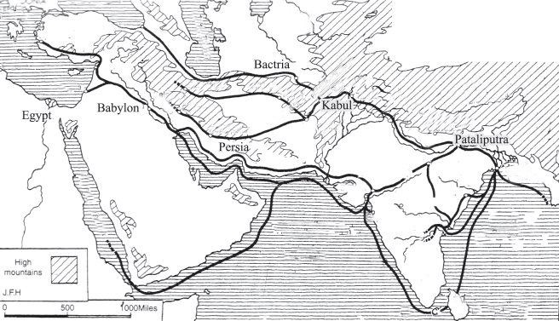

Slide 25
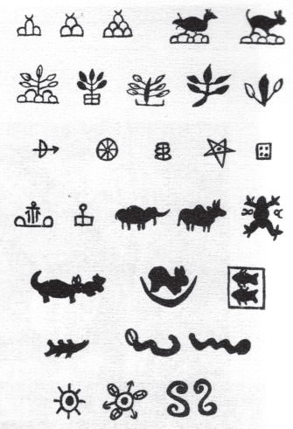
Punch-marked coins were used for
trade and for payment of wages.
Mines and metallurgy were
controlled by the government.
The government officials collected
taxes from the traders.
The accuracy of weights and
measures was ensured.

Slide 26
Different kinds of taxes of period are mentioned in the Arthashastra
Taxes Sectors in which the tax was imposed
Bhaga Tax on land
Bali Tax on fruits and flowers
Udagabhaga Tax on Water
Shulka Tax on export and import of goods.

Slide 27
Social life
Arthashastra describes about slaves who were known as 'Dasas'.
Joint family system prevailed in the society.
According to Megasthenes, there existed seven social divisions at that time.

Slide 29
India After the Mauryas

Slide 30
India After the Mauryas
After the decline of the Maurya dynasty different groups of people arrived India through its northwest part.Small Kingdoms were strengthened.
Important groups among them were..
Kushana Dynasty
Satavahana dynasty

Slide 31
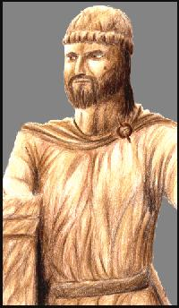
The Kushanas
Kanishka was the notable ruler among the Kushanas.
He started the Shaka era in 78 C E
(This later became the official calendar of India).

Slide 32
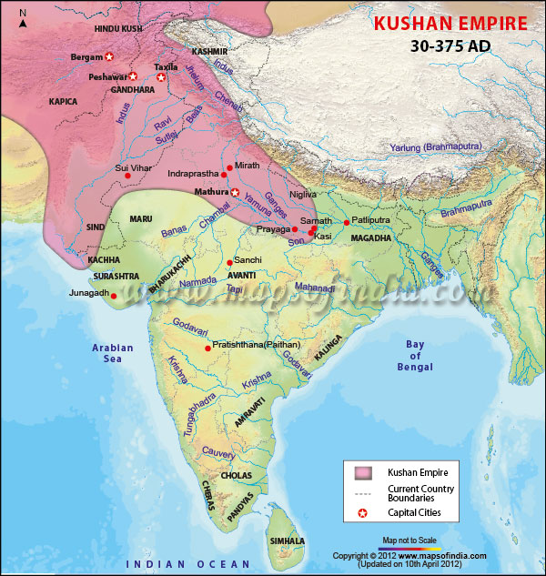

Slide 33
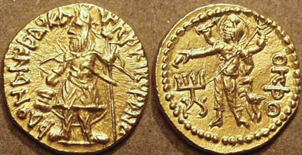
Buddhist scholars like Asvaghosha and Vasumitra, the prominent figures in the field of medicine- Charaka and Sushruta, lived during this period.
The Kushanas were the first to introduce gold coins in India.

Slide 34
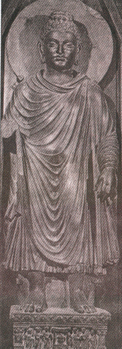
Gandhara art &Sculpture
A new style of sculpture emerged as a result of the merging of the style of Greece and Rome with Indian style of sculpture.
This is known as the Gandhara sculpture.

Slide 35
A group of Buddhists known as Mahayana Buddhists worshipped the statues of Buddha .
Kanishka encouraged Mahayan Buddhism and declared it as the official religion of the empire. .

Slide 36
The Satavahanas
The Satavahanas emerged as the rulers in central and south India after the Maurya rule.
Pratishthana (presently Paithan located in Maharastra) was the capital of the Satavahanas.

Slide 37
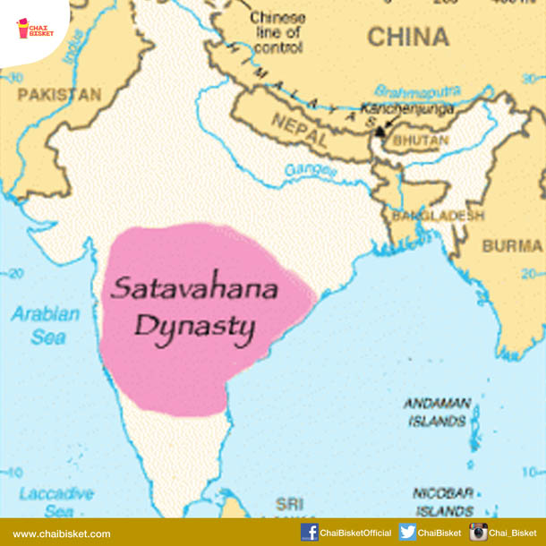

Slide 38
Kings like Gautamiputra Satakarni, Vasishthiputra extended the power of the kingdom.

Slide 39
The Satavahana rulers donated land to Buddhist monks and Brahmanas. The aim of such donations was to enlarge the area of agricultural land. Gradually the administrative power of these places was given to them.
This weakened the power of the kings.

Slide 40
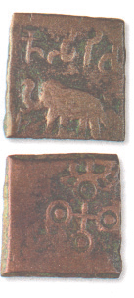
During that period, India had trade relations with the Roman Empire.
Roman gold coins were found from many places in India.

Slide 41
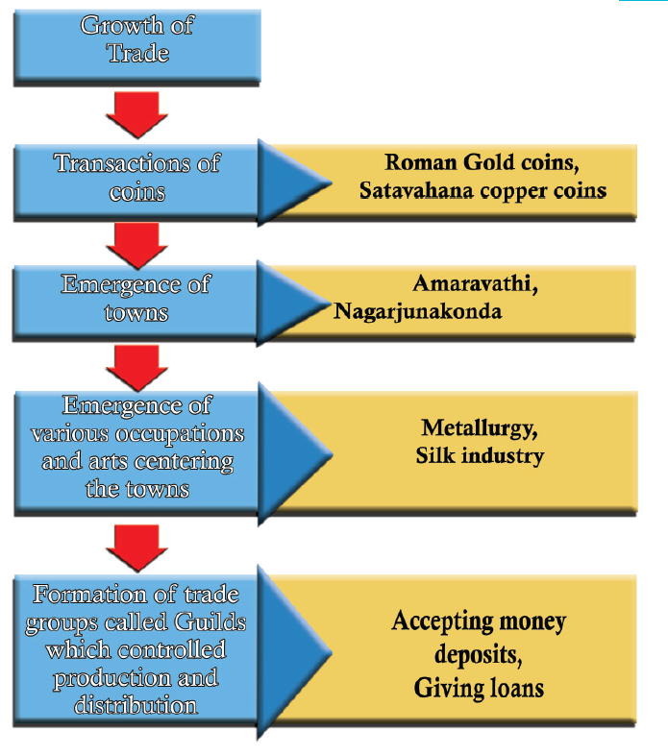
The changes that happened due to the growth of trade

Slide 42
The Guptas
After the decline of the Maurya empire, the empire that developed in the Gangetic plain was the Gupta empire.
Chandragupta I was the first powerful Gupta ruler.
He introduced the Gupta era in 320 C E.

Slide 43
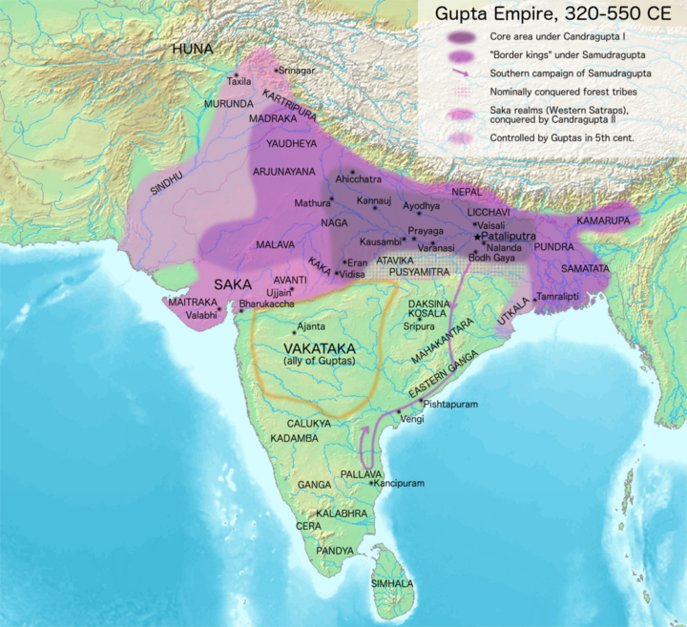

Slide 44
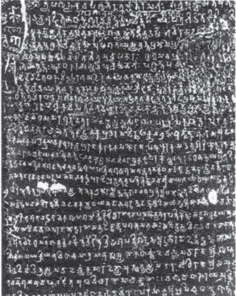
Samudragupta, who succeeded him, extended the empire.
We got information about Samudragupta's attacks from the 'Prashasti' written by his court poet Harisena.
The 'Prashasti' is inscribed on the pillar in Allahabad.

Slide 45
After Samudragupta, the Gupta empire was enlarged by Chandrgupta II.
He transferred the capital from Pataliputra to Ujjain.
The Navaratnas, who were famous in various fields, lived in his court.

Slide 46
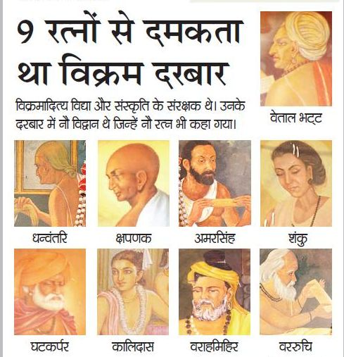

Slide 47
Navaratnas (Nine Gems)
Kalidasa, Khadakarpara,Kshapanaka, Vararuchi, Vetala ,Bhatta, Varahamihira, Amarasima, Shanku, Dhanvantari.

Slide 48
During this period, the Chinese traveller Fa-Hsien visited India.
A large number of gold coins were in cirulation during the time of Samudragupta and Chandragupta II.
Kumaragupta and Skandagupta were the successors of ChandraguptaII.

Slide 49
Life of People
A large extent of land was donated to Jain saints, Buddhist monks, Brahmanas and to the officials in the palace.
Those who got the land were given the right to exchange it. They made the farmers work in their land. But the farmers had no right on the land. There was an increase in agricultural production whereas the life of the farmers was pathetic.

Slide 50
Decline
The fall of the Roman empire caused for the decline of trade during the Gupta period.
The decline of trade attracted more people to the field of agriculture.
Towns lost their significance.
Power was concentrated on the landlords.
The royal power weakened.

Slide 51
Society
Various kinds of discriminations existed in the society during that time.
Varna system became rigid.
The kings encouraged Vaishnava and Shaiva sects and built many temples.

Slide 52
Literature and science
During the Gupta period, significant developments occurred in the fields of literature and science.
A number of books were written in Sanskrit language.

Slide 53
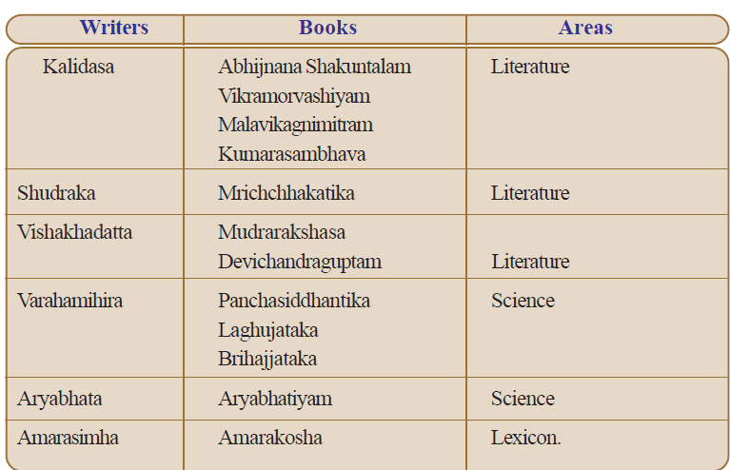

Slide 54
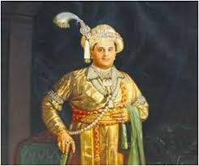
Vardhana Kings of Thaneswar
After the collapse of the Gupta empire, one of the powerful kingdoms that existed in India was that of the Vardhana Kings of Thaneswar (present Kurukshetra district of Haryana)
Harshavardhana was the most prominent ruler among them.
He worked for the uplift of Buddhism.
He took steps for the development of Nalanda University.

Slide 55
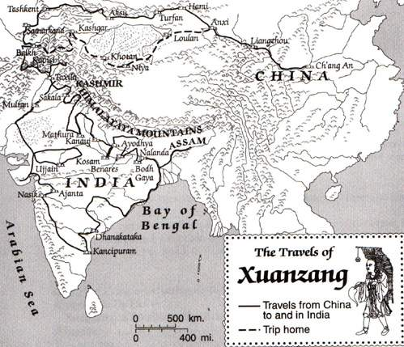
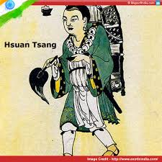
Ratnavali, Priyadarshika and Nagananda are the plays written by him.
The Harshacharita written by Banabhatta and the descriptions of the Chinese traveller Hsuan Tsang are the main sources for getting information on this period.

